Slide 1
Approximation Algorithm

Slide 2
Introduction
Approximation algorithms are a class of algorithms designed to find solutions to optimization problems where obtaining an exact solution is computationally infeasible.
These problems are not solvable in polynomial time.
These problems are known as NP hard problems.
These problems are significantly effective to solve real world problems.

Slide 3
Introduction
Use of heuristics may help to solve a large instance of problem quickly. We have seen backtracking and branch-and-bound.
A heuristic, however, does not work equally effectively on all problem instances. Depending on input, they may take exponential time.
Instead of finding an optimal solution, we will try to find a solution that is closer to optimal solution.

Slide 4
Introduction
A feasible solution with value close to the value of an optimal solution is called an approximate solution.
An approximation algorithm for P is an algorithm that generates approximate solutions for P.

Slide 5
Vertex Cover Problem
A vertex cover of an undirected graph is a subset of its vertices such that for every edge (u, v) of the graph, either 'u' or 'v’ or both is in the vertex cover.
Although the name is Vertex Cover, the set covers all edges of the given graph.
Given an undirected graph, the vertex cover problem is to find minimum size vertex cover.

Slide 6
Vertex Cover Problem
Given a graph G=(V,E):
V = set of vertices (nodes)
E = set of edges (connections)
A vertex cover is a subset of vertices C⊆V such that:
Every edge in the graph has at least one endpoint in C.

Slide 7
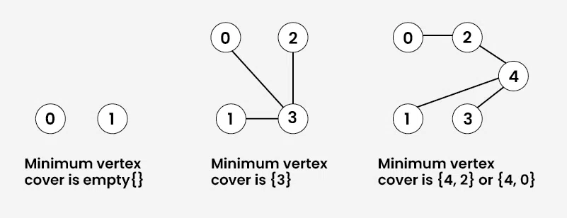
Vertex Cover Problem

Slide 8
Vertex Cover Problem-Algorithm
Step 1 − Select any random edge from the input graph and mark all the edges that are incident on the vertices corresponding to the selected edge.
Step 2 − Add the vertices of the arbitrary edge to an output set.
Step 3 − Repeat Step 1 on the remaining unmarked edges of the graph and add the vertices chosen to the output until theres no edge left unmarked.
Step 4 − The final output set achieved would be the near-optimal vertex cover.

Slide 9
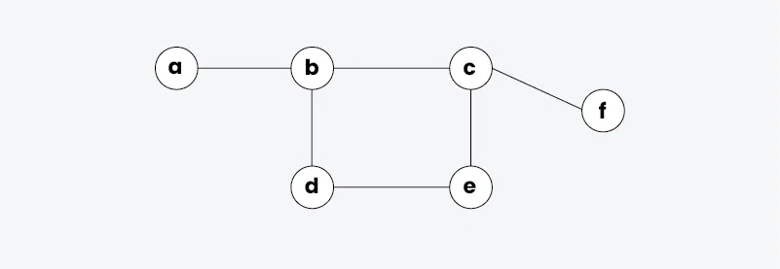
Example

Slide 10
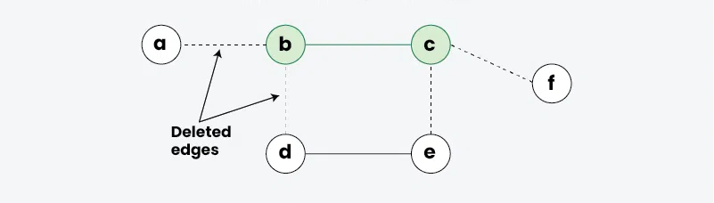
Example
Pick edge (b,c)
Insert b and c to minimum vertex cover and delete all the adjacent edges.

Slide 11
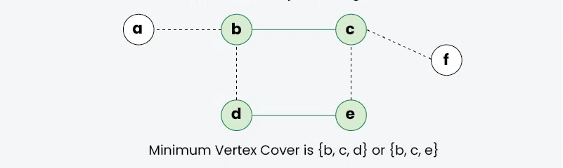
Example
Pick edge (d,e)
Insert d and e to minimum vertex cover and delete all the adjacent edges.

Slide 12
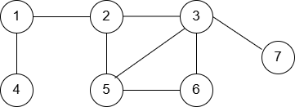
Example
Lets do it in an optimized way.

Slide 13
Applications
Have you ever wondered about the placement of traffic cameras? That how they are efficiently placed without wasting too much budget from the government?
The answer to that comes in the form of vertex-cover algorithm. The positions of the cameras are chosen in such a way that one camera covers as many roads as possible.
i.e., we choose junctions and make sure the camera covers as much area as possible.

Slide 14
Thank You

